Slide 1
Google BERT
By Kseniia Striukova

Slide 2

What is the BERT Algorithm?
BERT — Bidirectional Encoder Representations from Transformers — is a neural network-based technique that facilitates a natural language processing (NLP) pre-training approach. In layman’s terms, BERT helps Google get a better understanding of the context of user search queries.

Slide 3

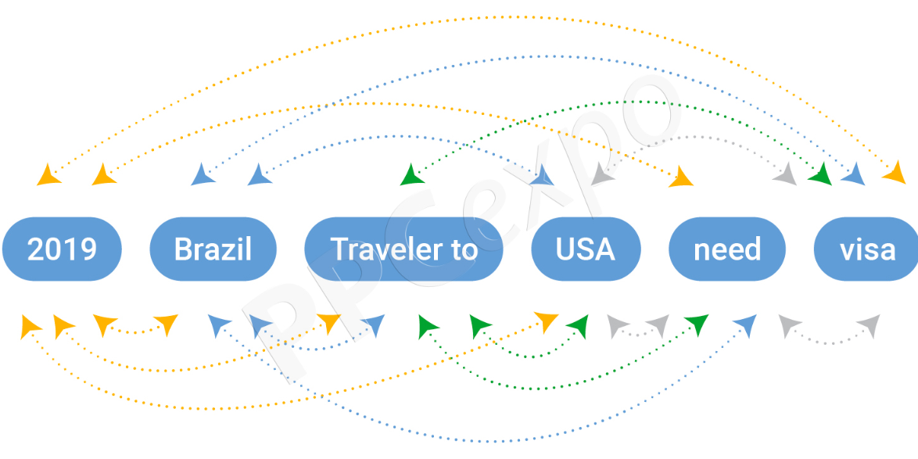
What is the BERT Algorithm?

Slide 4
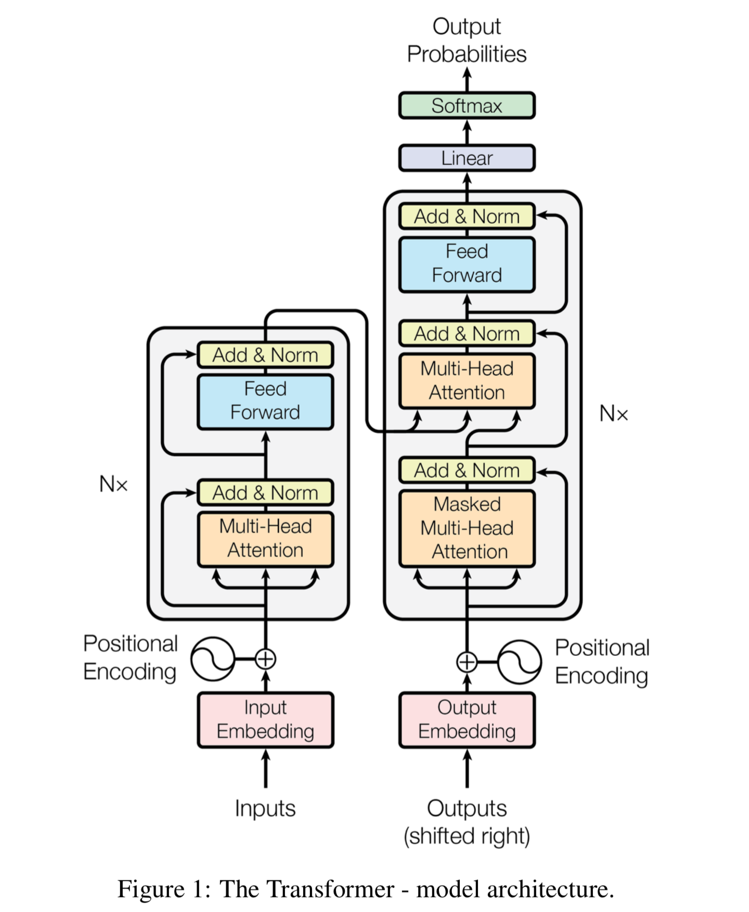
BERT - architecture of model
BERT is a transformer-based architecture.

Slide 5
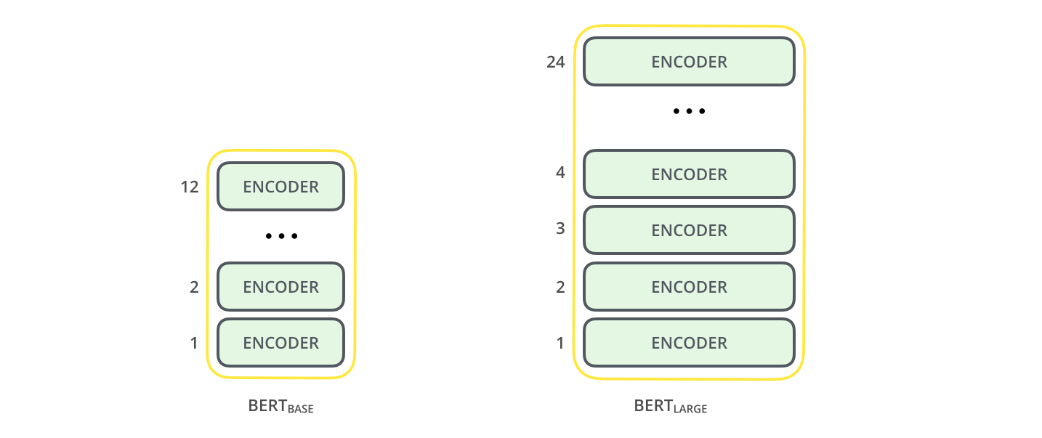
BERT - architecture of model
BERT is a multi-layered encoder. In that paper, two models were introduced, BERT base and BERT large. The BERT large has double the layers compared to the base model. By layers, we indicate transformer blocks. BERT-base was trained on 4 cloud-based TPUs for 4 days and BERT-large was trained on 16 TPUs for 4 days.

Slide 6
How was BERT trained?
MLM (Masked Language Modelling)
In the sequence, we randomly mask some percentage of words, by replacing them with token [MASK]. In the paper, they had masked 15% of input words.
Next Sentence Prediction (NSP)
To understand the relationship between two sentences, BERT uses NSP training. The model receives pairs of sentences as input, and it is trained to predict if the second sentence is the next sentence to the first or not.

Slide 7
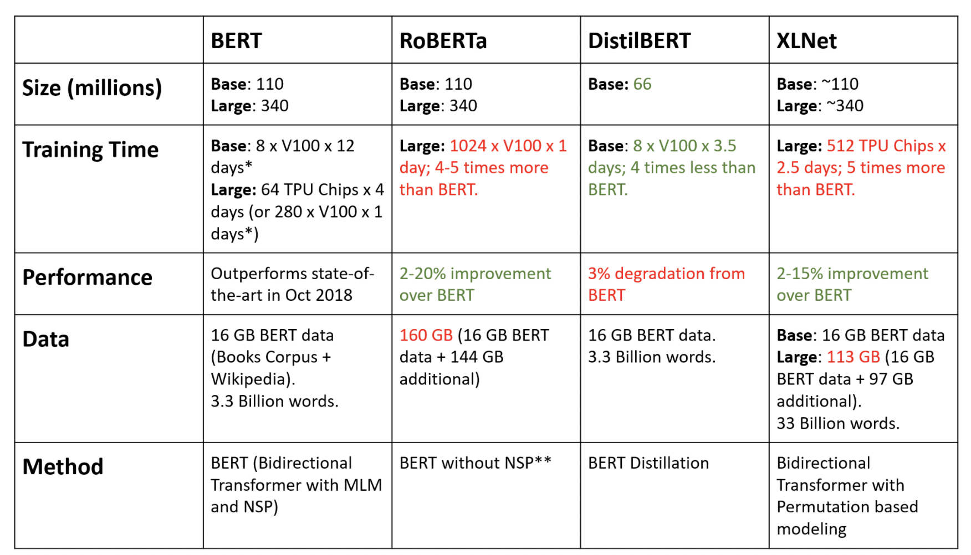
Comparison with similar Transformers

Slide 8

How Does Google BERT Affect Content Marketing?
Now that Google is working harder to discern the context and intent of user search queries, content marketers must ensure they deliver higher quality content that is relevant for their target readers.
BERT is a huge step forward in the development of search engines, and so companies need to get in line if they are to generate a positive return on investment (ROI) from their content marketing efforts.

Slide 9
Thank you!

